Slide 1

INTRO TO
ENGINEERING
Engineering is a type of science focused on building or improving machines and structures.
Engineers aim to solve problems and improve the world by designing safer, more efficient technology like planes, phones, computers, and buildings.
Engineers solve problems in two ways:
Invention: Creating something completely new to address a problem.
Innovation: Improving an existing idea to make it better.

Slide 2

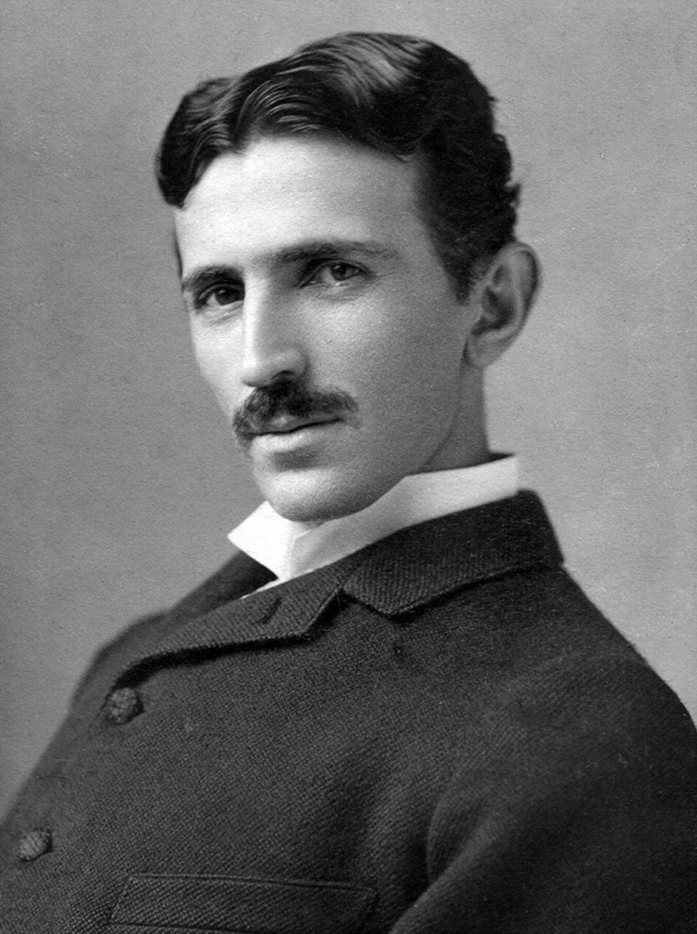
WHAT IS
ENGINEERING?
Engineering is a type of science focused on building or improving machines and structures.
Engineers aim to solve problems and improve the world by designing safer, more efficient technology like planes, phones, computers, and buildings.
Engineers solve problems in two ways:
Invention: Creating something completely new to address a problem.
Innovation: Improving an existing idea to make it better.

Slide 3




ENGINEERING FIELDS
WE WILL EXPLORE
Civil Engineers Involved in the safe construction and maintenance of infrastructure | Mechanical Engineers Design, test, and fix machinery such as engines and robots. | Aerospace Engineers Involved in the designing and testing of aircraft and spacecraft. | Chemical Engineers Combine chemistry and engineering to solve problems.

Slide 4
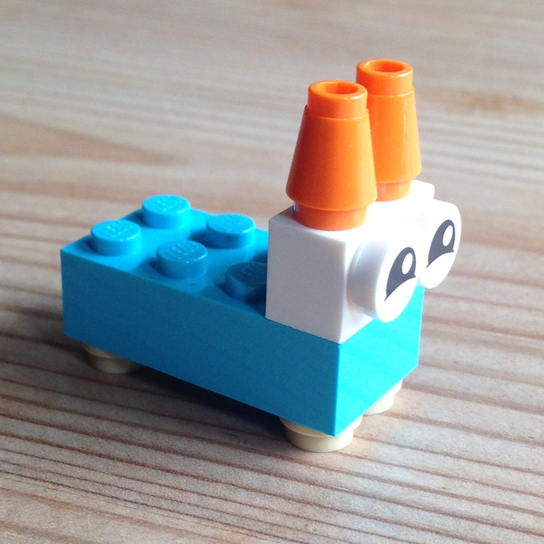
ACTIVITY
WRITE IT, BUILD IT
Get into groups of two, and designate a writer and a builder
The Writers may come up to the front of the room and look at a fully assembled Lego structure
Writers will have 15 minutes at most to write down a precise building instructions to their partner
You can ONLY use words, no diagrams, drawings, photos, etc.
The builder is not allowed to see the structure
The builder will then have at most 20 minutes to reconstruct the structure with the Lego Bricks provided
The builder must only use the instructions provided
EXAMPLE INSTRUCTIONS:
“Take the 4x2 Light Blue Lego piece. Attach a white circle piece to each corner. Then add a...”

